Slide 1

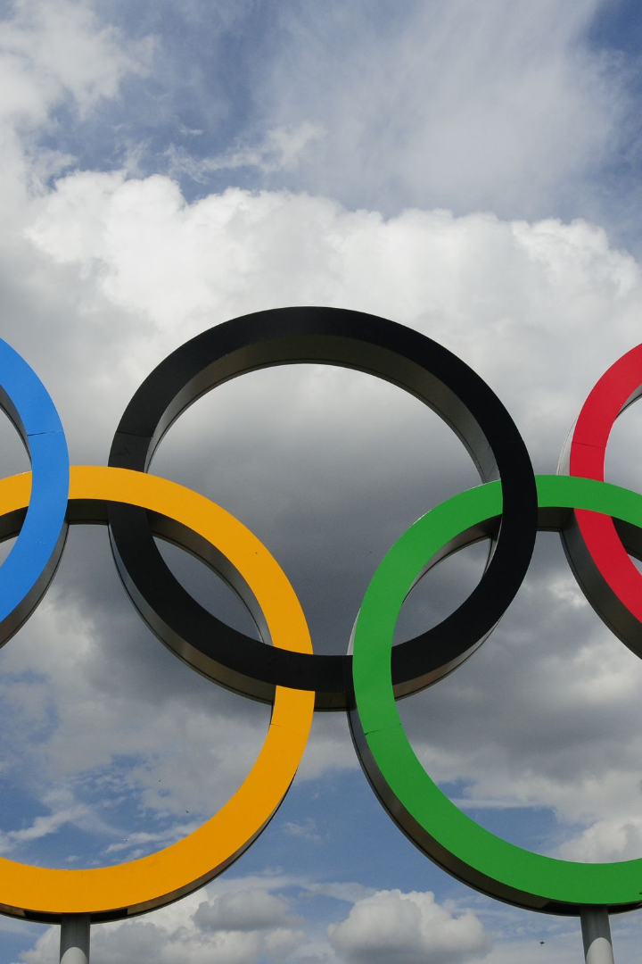

OLYMPIC DATA SET CAPSTONE PROJECT
Welcome to this captivating presentation on the Olympic Data Set! Get ready to explore the fascinating world of Olympic statistics through the lens of Power BI and EDA.
by Vishesh Shivhare

Slide 2
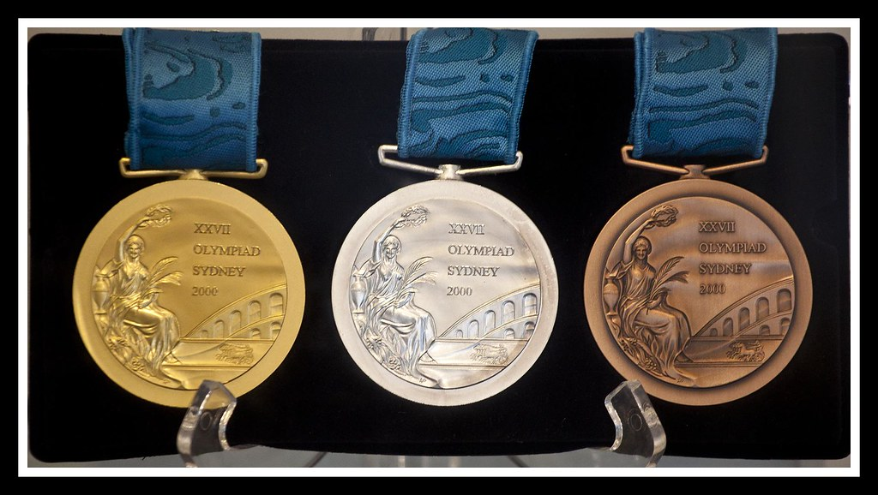
INTRODUCTION TO OLYMPIC DATSET
The Olympic dataset is a comprehensive collection of data related to the Olympic Games, spanning from the inaugural modern Olympics in 1896 to the 2016 Games. This dataset includes a wide range of information, such as details about the host cities, participating countries, sports, events, athletes, and, most importantly, medal results.
The dataset serves as a valuable resource for researchers, historians, and sports enthusiasts, providing insights into the history and evolution of the Olympics. It allows for the analysis of medal trends, the performance of individual athletes and countries, and the growth of the Games over time.

Slide 3

POWER BI REPORT

Slide 4
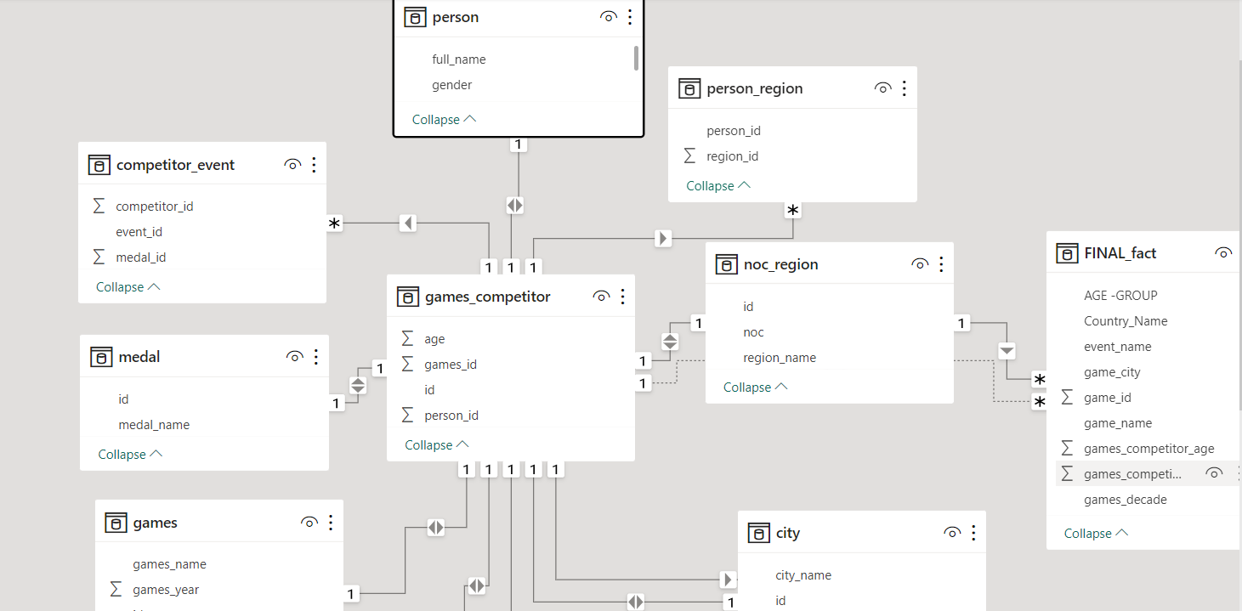
ER DIAGRAM

Slide 5

ER DIAGRAM

Slide 6
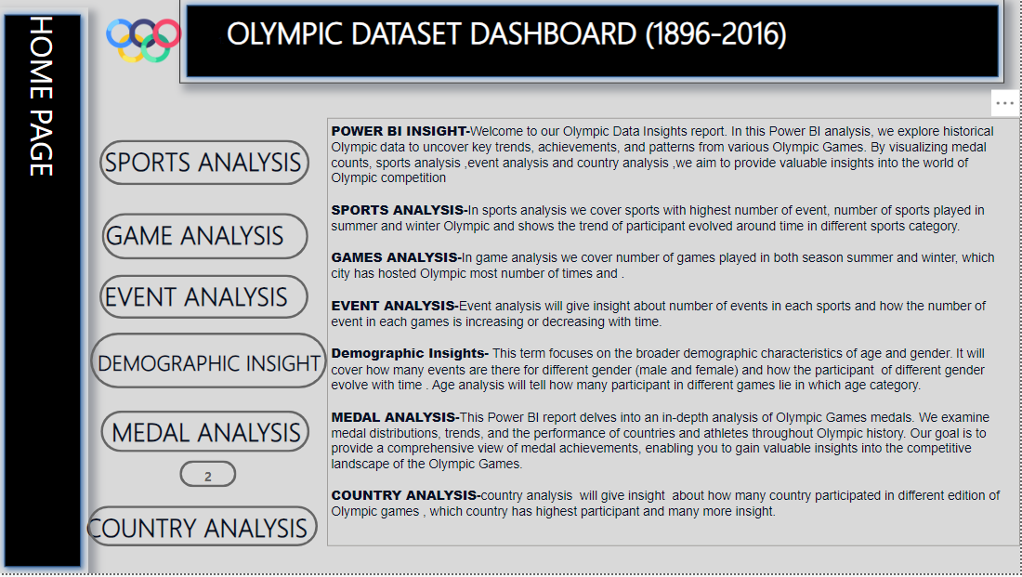
DESCRIPTION OF DIFFERENT PAGES OF DASHBOARD

Slide 7
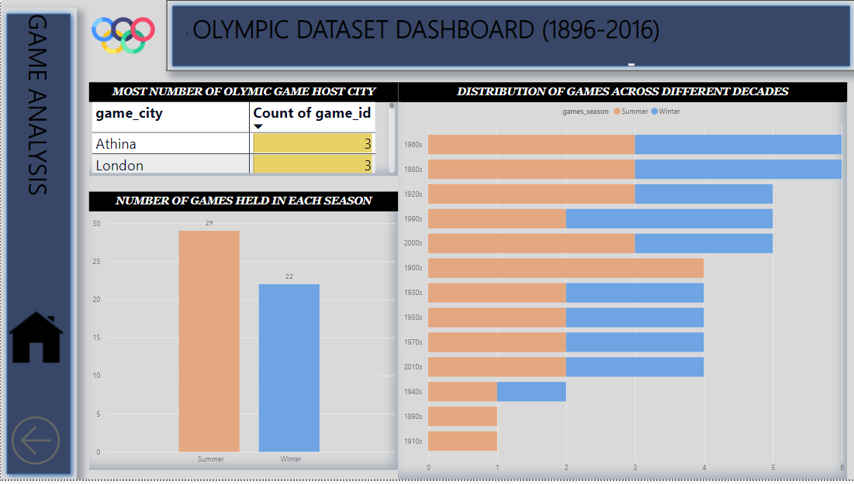
GAME ANALYSIS

Slide 8
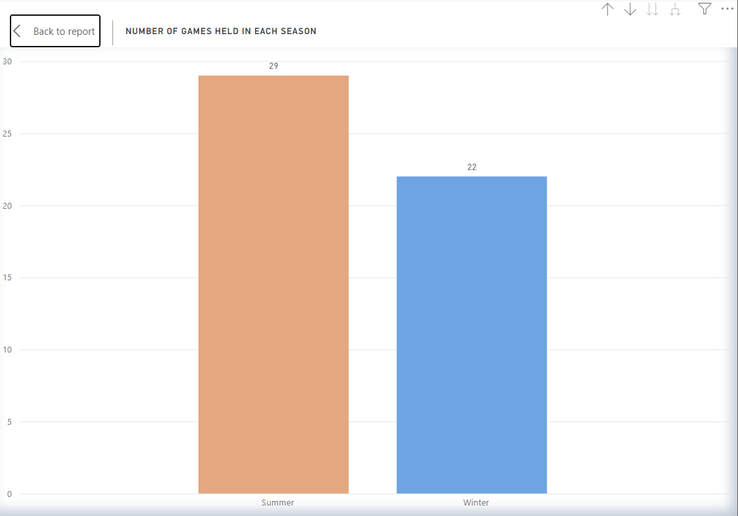
How many Olympic Games have been held in each season (Summer vs. Winter)?
Summer Olympics were held in every even-numbered year starting from 1896 (with the exception of 1916, 1940, and 1944 due to World Wars I and II) up to 2016. This includes 29 Summer Olympics in total during this period.
The Winter Olympics were introduced later, with the first Winter Games taking place in 1924. Similar to the Summer Olympics, they were held in every even-numbered year, except for 1940 and 1944 due to World War II. Up to 2016, there were 22 Winter Olympics held during this period.

Slide 9
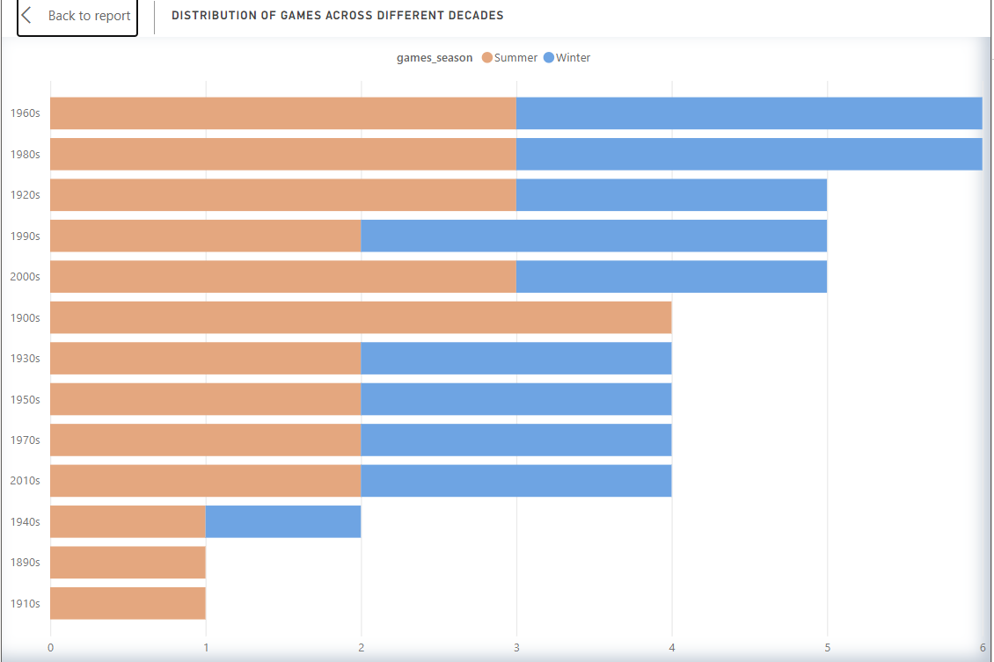
What is the distribution of games across different decades?
The number of Olympic Games held in each decade varied, with the highest number of games occurring in the 1960s and 1980s (6 each). There were only 2 Olympics during the 1940s due to World War II. Overall, the Olympics have been a consistent international sporting event, with both Summer and Winter Games taking place in various decades, showcasing the world's top athletes and promoting sportsmanship and international cooperation

Slide 10
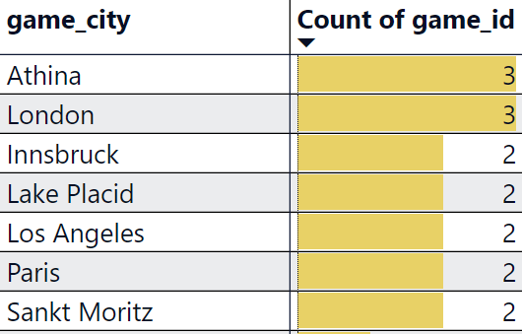
Which cities have hosted the most Olympic Games?
Athens, Greece: Athens has hosted the Summer Olympics three times, in 1896 (the inaugural modern Olympics) and again in 1906 and2004
London, United Kingdom: London has hosted the
Summer Olympics three times. The city hosted the games in 1908, 1948, and 2012
St. Moritz, with two hosting opportunities in 1928 and 1948, established itself as an early favorite for Winter Olympic events. The United States' Lake Placid followed suit with successful games in 1932 and 1980. Innsbruck, Austria, also hosted the Winter Games twice, in 1964 and 1976, highlighting the city's strong association with winter sports.

Slide 11
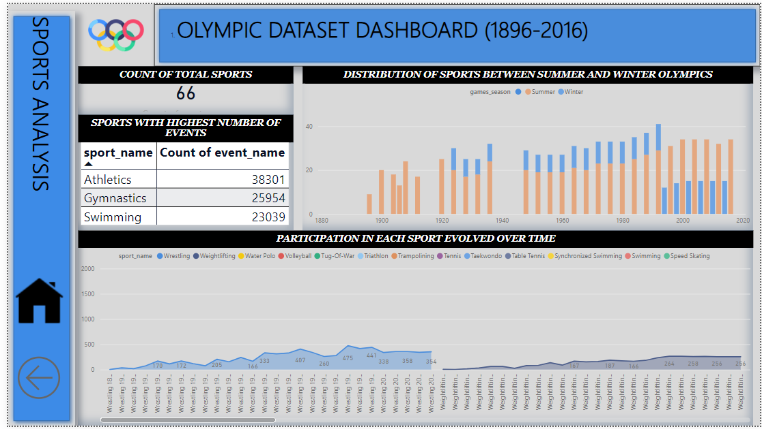
SPORTS ANALYSIS

Slide 12
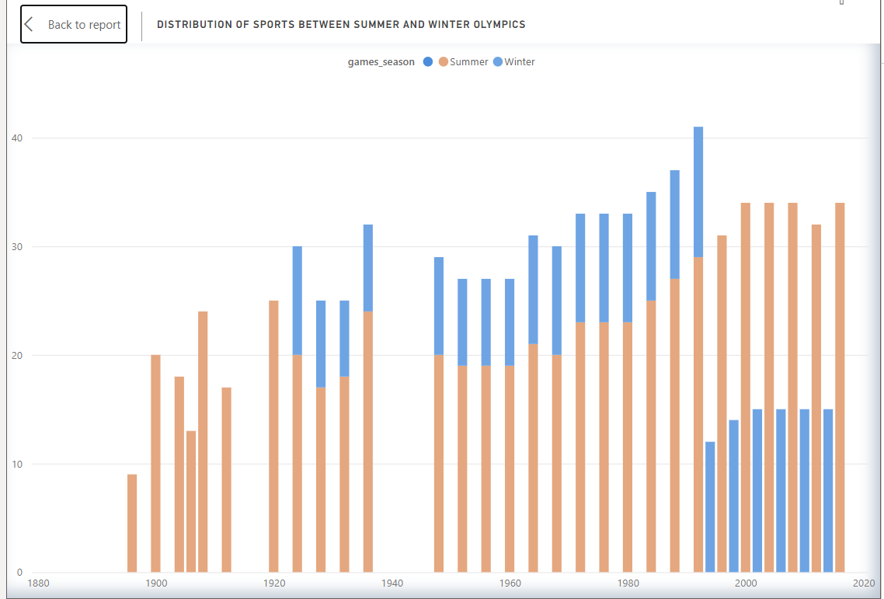
What is the distribution of sports between Summer and Winter Olympics?
The distribution of sports between the Summer and Winter Olympics underscores the influence of climate and weather conditions on the selection of sports. The Summer Olympics have consistently included a more extensive and diverse array of sports, showcasing both individual and team competitions across a broad spectrum of athletic disciplines. In contrast, the Winter Olympics have focused on sports that require specific winter conditions, such as snow and ice, resulting in a more specialized program. In year 1924
Summer Olympic has 20 sports while winter has only 10

Slide 13
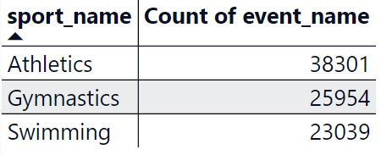
Which sports have the highest number of events in the Olympics?
Athletics :
Athletics has consistently had the highest number of events in the Summer Olympics. With 38301 events
Gymnastics:
Gymnastics features both artistic gymnastics and rhythmic gymnastics for men and women with 25954 events
Swimming:
Swimming is another sport with a significant number of events in the Summer Olympics With 23039 events
.

Slide 14
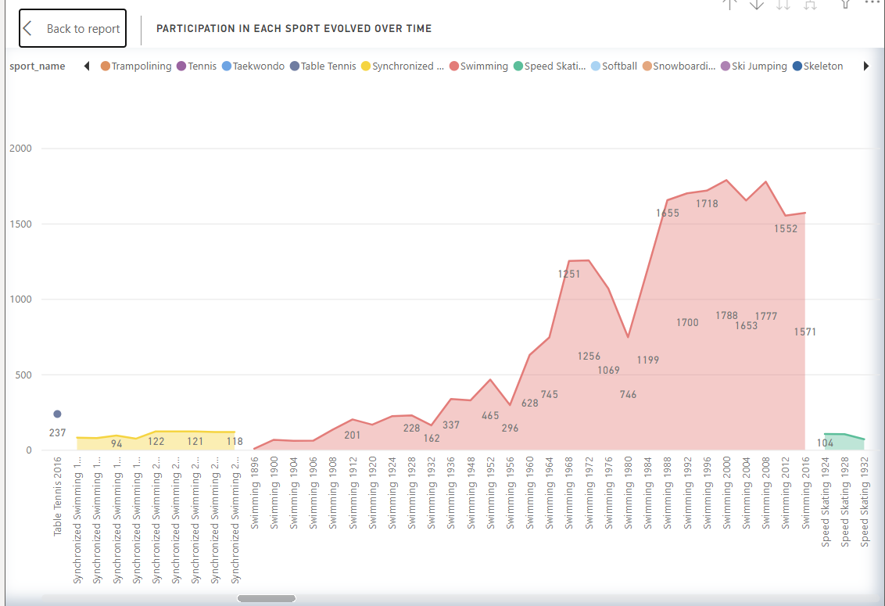
How has the participation in each sport evolved over time?
The participation in each sport at the Olympic Games has evolved to reflect changes in sports culture, global trends, and societal developments. The Games have expanded to include more sports, events, and athletes from diverse backgrounds. Additionally, there has been a concerted effort to promote gender equality in Olympic sports, resulting in increased opportunities for female athletes. The inclusion of new sports and events continues to adapt the Olympics to the evolving interests and athleticism of the world's population
.

Slide 15
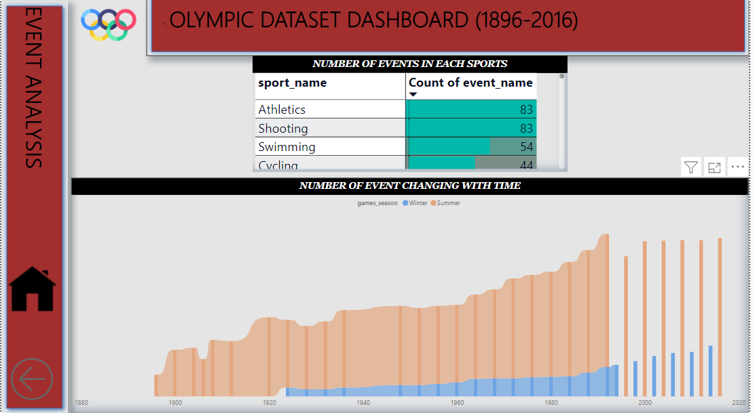
EVENT ANALYSIS
.

Slide 16
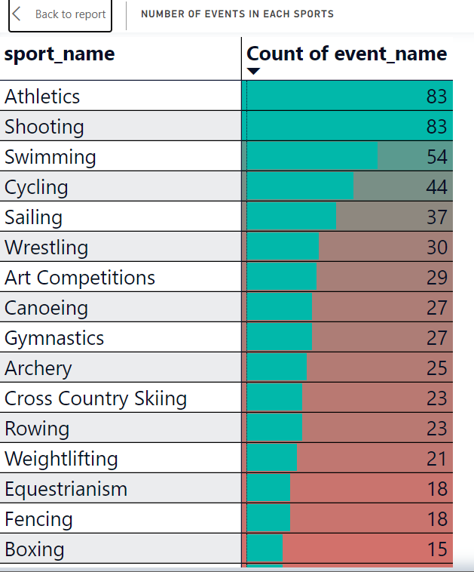
How many events are there in each sport?
The number of events in each sport at the Olympic Games has varied over the years from 1896 to 2016, reflecting changes in the sports program and the addition of new events.
.

Slide 17
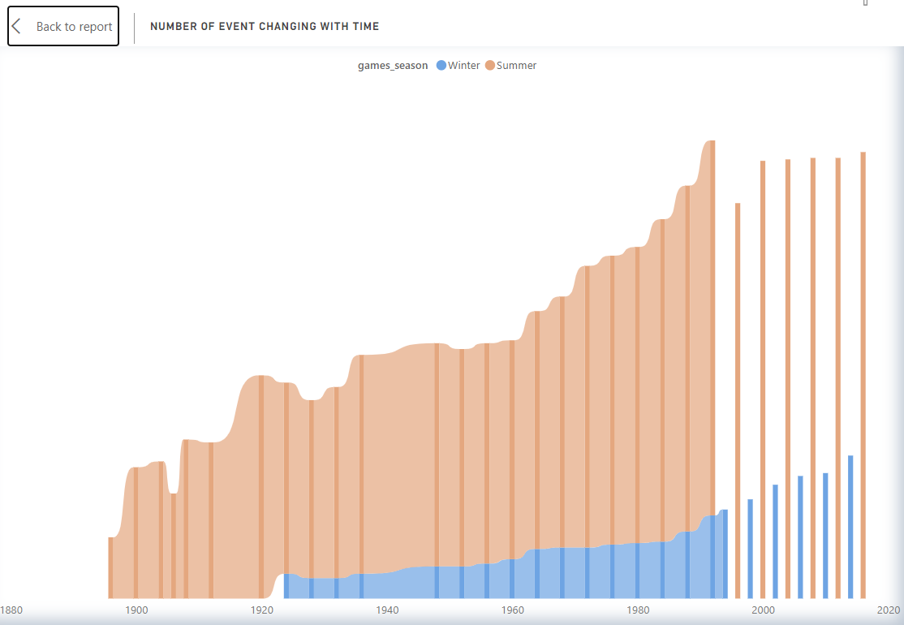
How has the number of events changed over time?
The number of events in the Olympic Games has significantly increased over time, driven by factors like gender equality initiatives, the introduction of new sports and disciplines, and the inclusion of mixed-gender and relay events. These changes have contributed to a more diverse and inclusive Olympic program, showcasing a wide range of athletic talents and promoting global sports participation. In year 1896 we have 42 events while we have 257 events in 1992
.

Slide 18
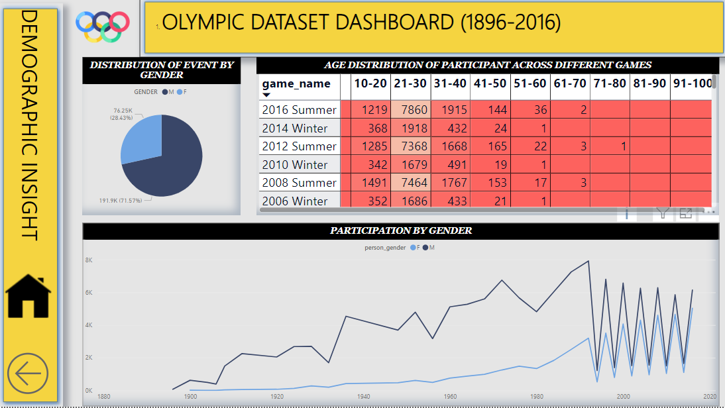
DEMOGRAPHIC INSIGHT
.

Slide 19
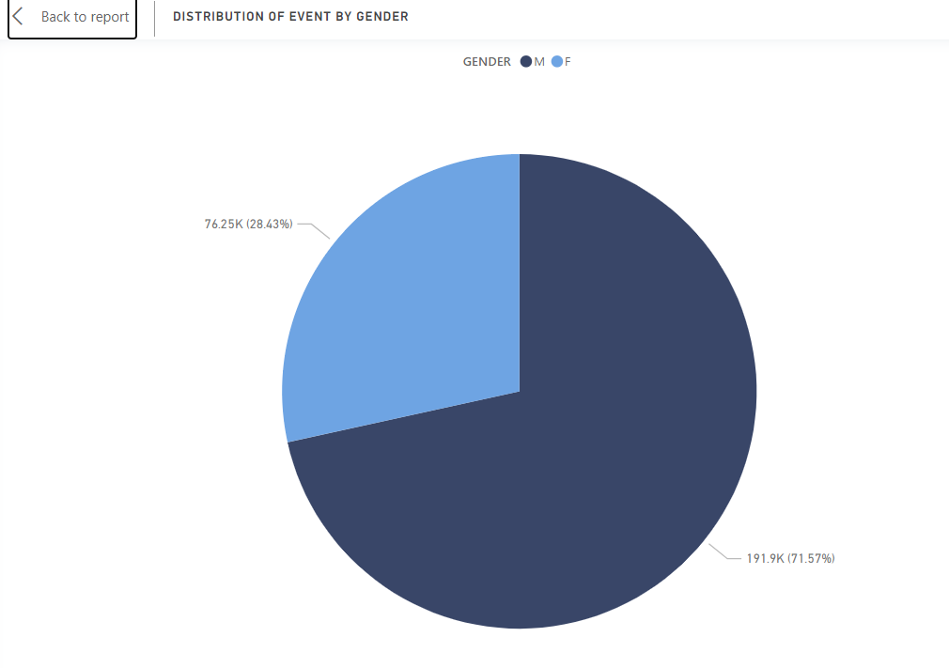
What is the distribution of events by gender (Men, Women, Mixed)
The distribution of events by gender at the Olympic Games has evolved significantly over time, with a growing emphasis on gender equality and inclusivity. Women's participation in the Olympics has expanded, resulting in more events and disciplines specifically for female athletes. Additionally, mixed-gender events and relay formats have been introduced to further promote diversity and cooperation in sports .we have only 28.43% event for female while 71.57% are for male
.

Slide 20
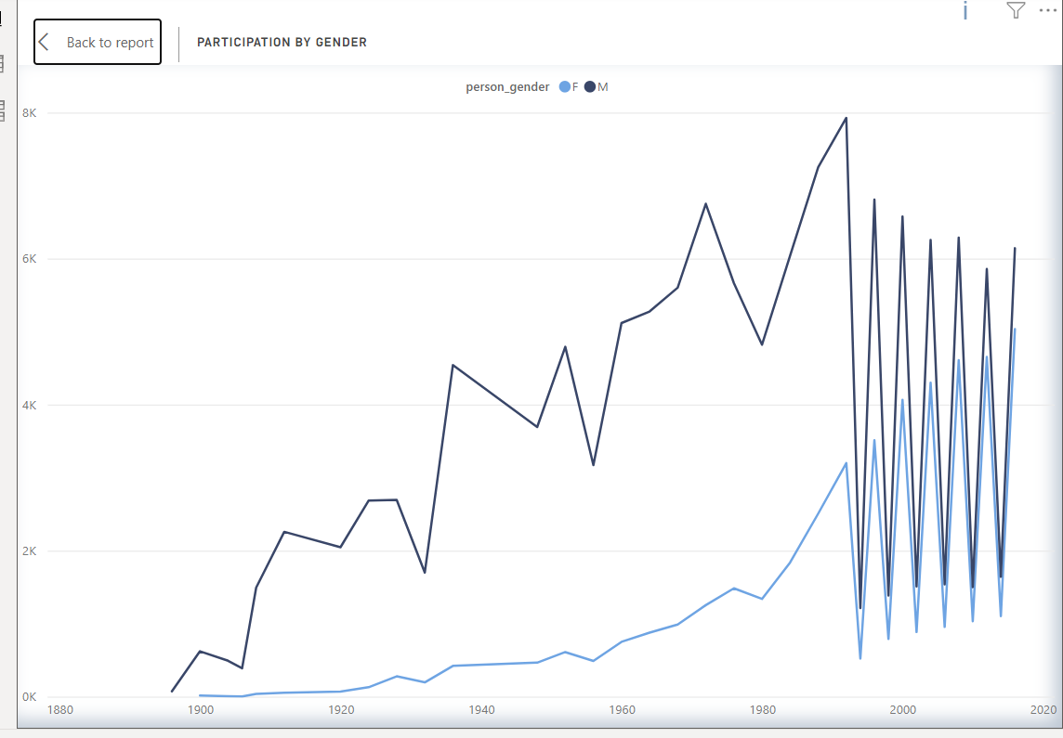
What is the distribution of participants by gender?
The distribution of participants by gender at the Olympic Games has evolved over time, with a notable increase in the number of female athletes and events for women starting from year 1992
.

Slide 21
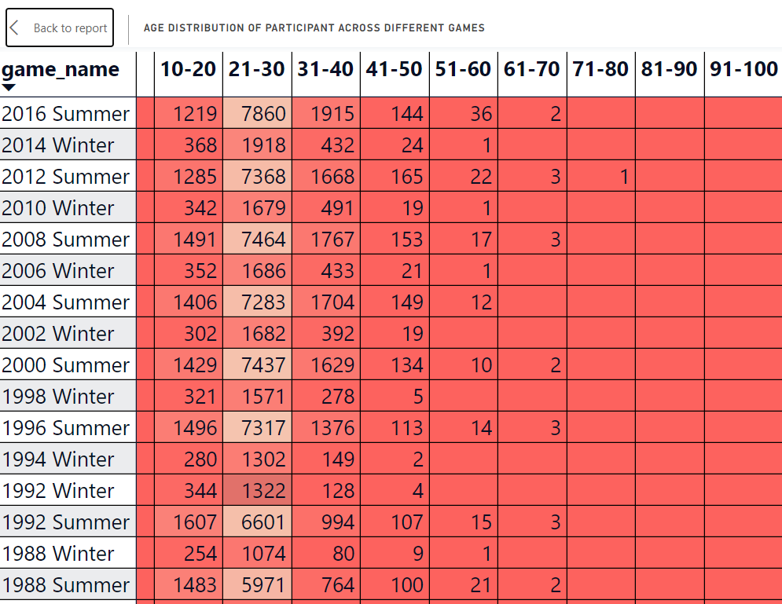
How does the age distribution of participants vary across different games
The age distribution of participants in the Olympic Games has varied across different editions and sports over the years from 1896 to 2016.
.

Slide 22
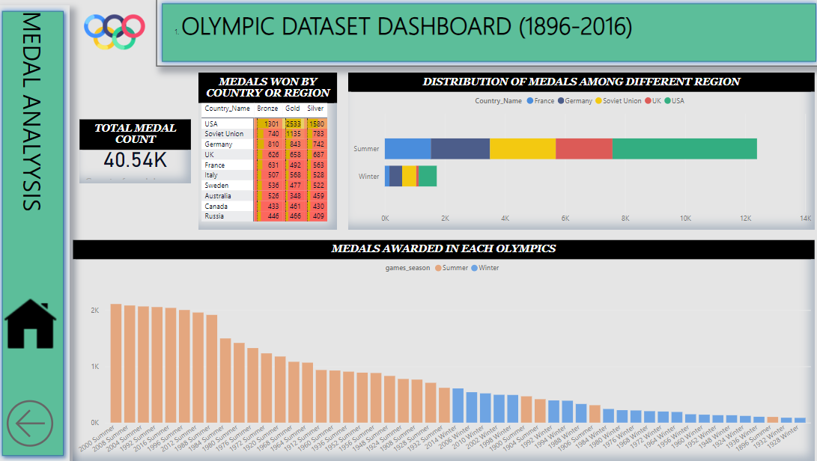
MEDAL ANALYSIS-1
.

Slide 23
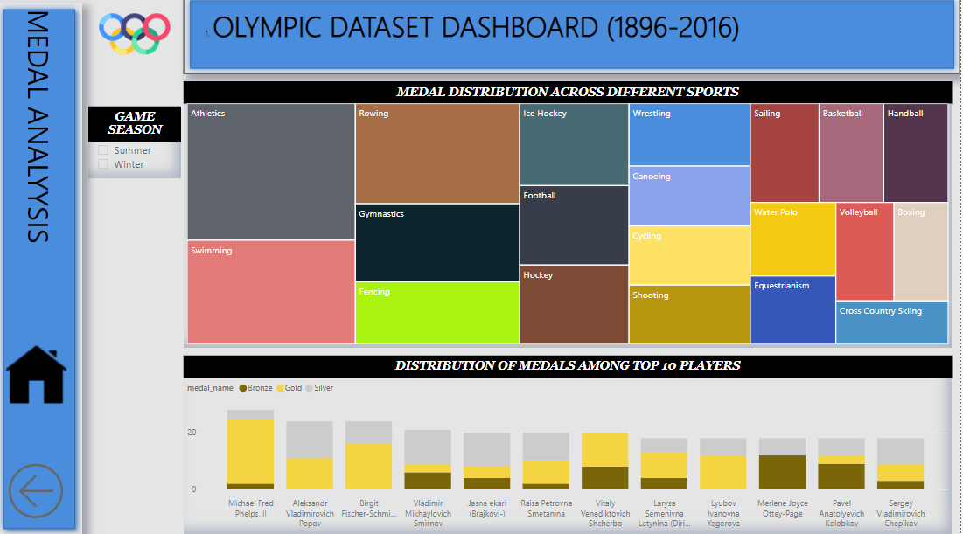
MEDAL ANALYSIS-2
.

Slide 24
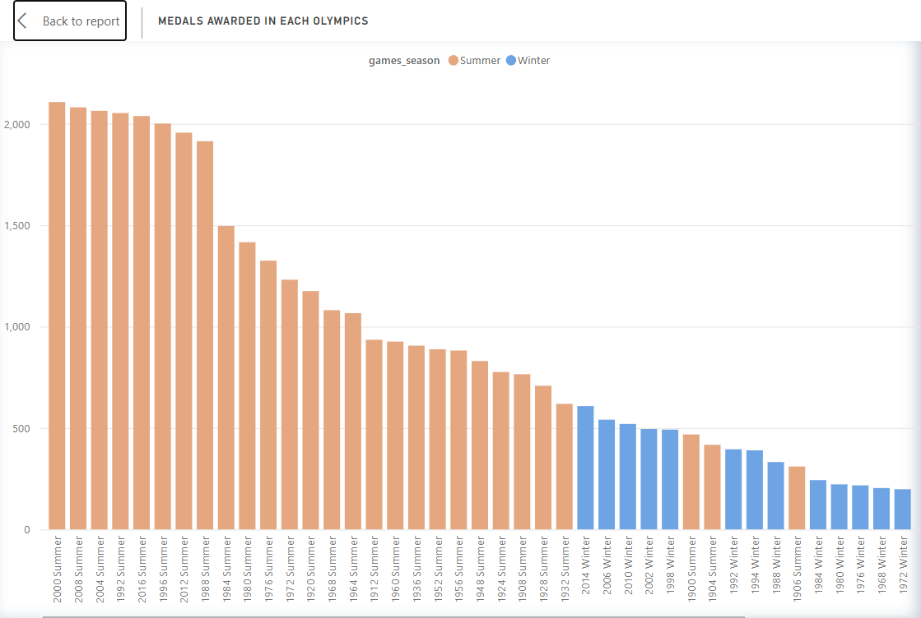
How many medals have been awarded in each Olympics?
The number of medals awarded at each Olympic Games has varied over time due to changes in the number of events and the inclusion of new sports and disciplines. Here's a summary of the approximate number of medals awarded at the Summer and Winter Olympics from 1896 to 2016 . With 2107 overall medal in 2000 summer Olympic
.

Slide 25
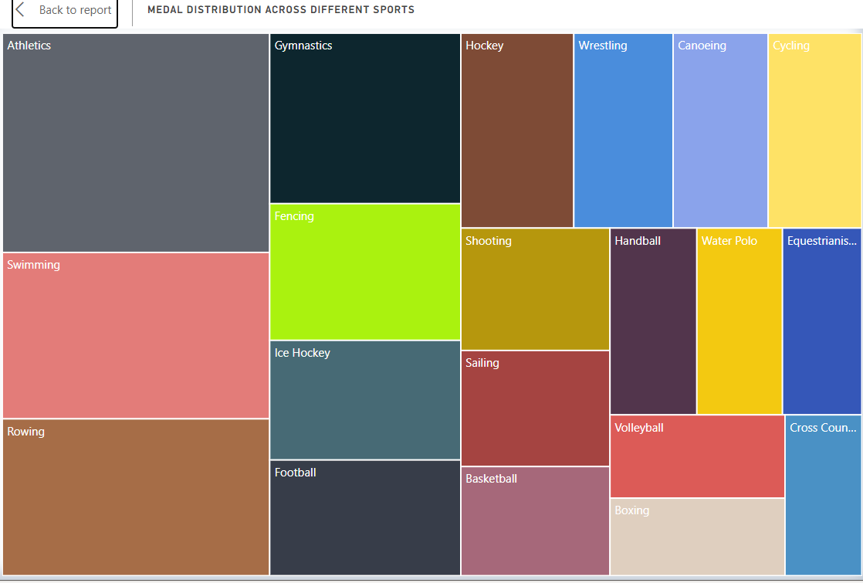
How does the medal distribution vary across different sports?
Athletics with 4053 overall medals in summer Olympic and ice hockey with 1554 overall medals in winter Olympics are the sports with highest number of medal won.
.

Slide 26
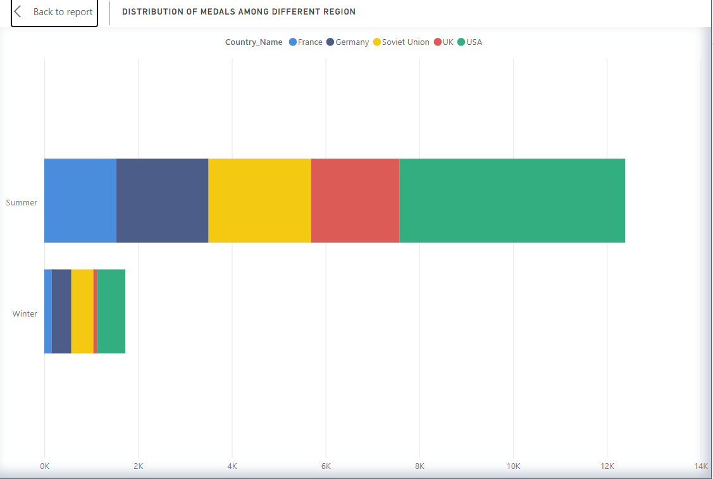
What is the distribution of medals among different regions?
The distribution of medals among countries like the United States, France, and Russia in the Olympic Games from 1896 to 2016 varies over time due to several factors, including the performance of athletes, changes in political boundaries (such as the Soviet Union's dissolution), and shifts in sports programs. screenshot is a general overview of the medal distribution for these countries during the period (1896-2016)
.

Slide 27
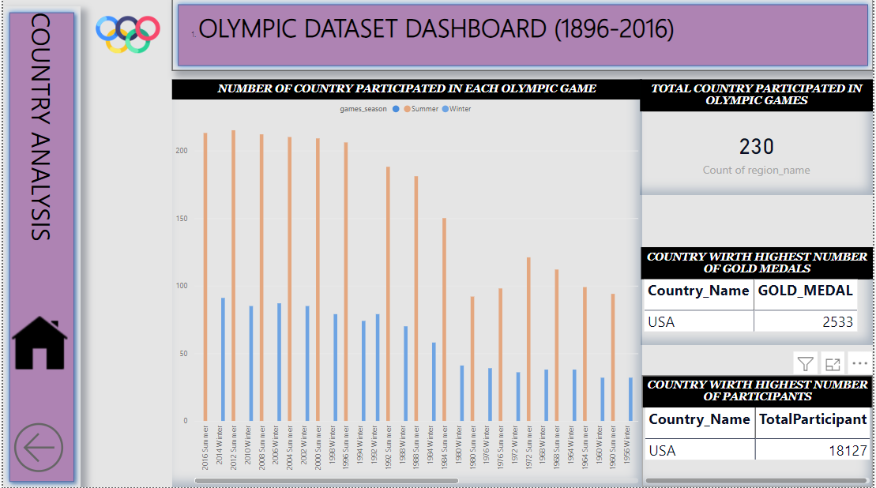
COUNTRY ANALYSIS
.

Slide 28
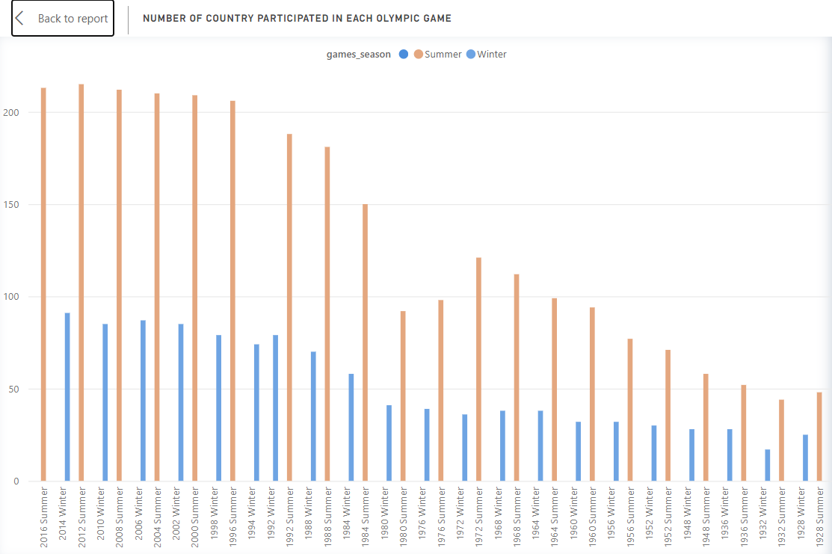
How many regions or NOCs participate in each Olympic Games?
The number of National Olympic Committees (NOCs) or regions participating in each Olympic Games has varied over time. Here's a general overview of the approximate number of participating NOCs or regions in both the Summer and Winter Olympics from 1896 to 2016:
Summer Olympics:
The number of participating NOCs in the Summer Olympics has steadily grown over the years.
In the early Olympics, only a handful of countries participated, but this number increased significantly as the Games gained popularity.
By the late 20th century and into the 21st century, the Summer Olympics featured over 200 participating NOCs.
Winter Olympics:
The Winter Olympics, which began in 1924, initially had a smaller number of participating NOCs compared to the Summer Olympics.
The number of participating NOCs in the Winter Olympics also grew over time as winter sports gained wider international participation.
By the 2010s, the Winter Olympics featured around 90 to 100 participating NOCs.
.

Slide 29
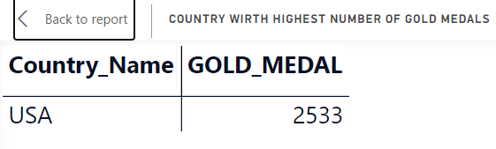
Which countries have the highest number of gold medals?
United States: The United States has won the most gold medals in the history of the Olympics .
.

Slide 30
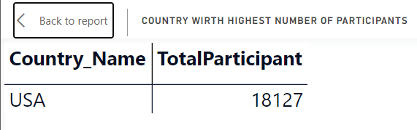
Which countries have the highest number of participants in the Olympics?
United States: The United States has consistently fielded one of the largest and most competitive Olympic delegations, participating in a wide range of sports and events
.

Slide 31

EDA ANALYSIS

Slide 32
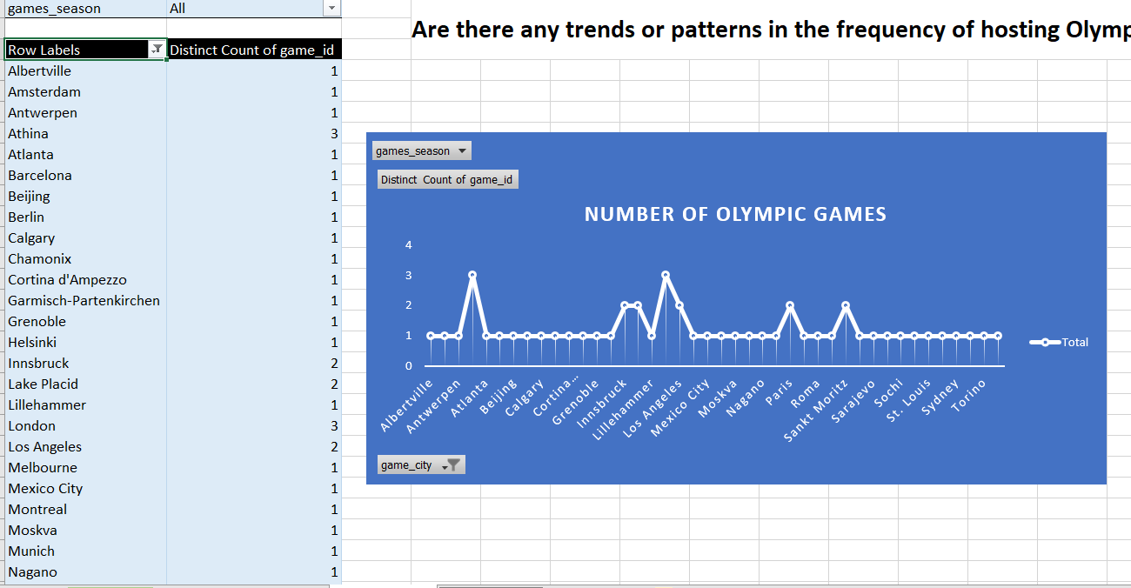
Are there any trends or patterns in the frequency of hosting Olympic Games?
Early Concentration in Europe: In the early years of the modern Olympics (late 19th and early 20th centuries), the Games were primarily hosted in European cities. This concentration was due in part to the Olympic Movement's European origins and the limited global participation at the time
.

Slide 33
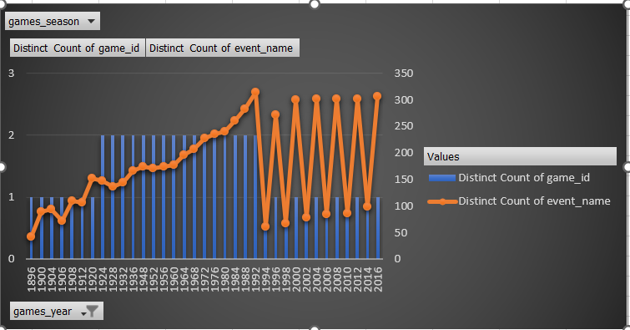
How has the duration of Olympic Games changed over time?
Overall, the duration of the Olympic Games has become more extended over time due to the growth in the number of events and athletes. The Summer and Winter Olympics were officially separated in terms of their scheduling starting in the year 1994. Prior to that, the Summer and Winter Olympics were often held in the same year or within a few months of each other
.

Slide 34
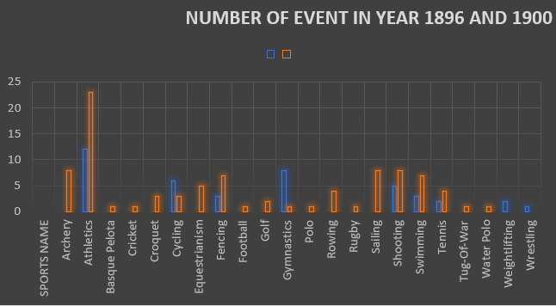
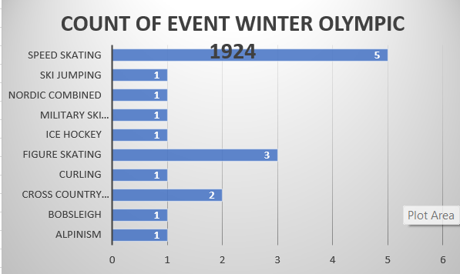
Are there any notable events or occurrences associated with specific Olympic Games?
The addition of new events AND SPORT in the 1900 Olympic Games, when compared to the inaugural 1896 Games, brought significant changes and expanded the scope of this prestigious sporting event. As we conclude our analysis of these two Olympic editions.
.
1924 introduced several innovations in Olympic sports, including the inclusion of winter sports as an integral part of the Games. This decision eventually led to the establishment of the Winter Olympics as a separate event

Slide 35
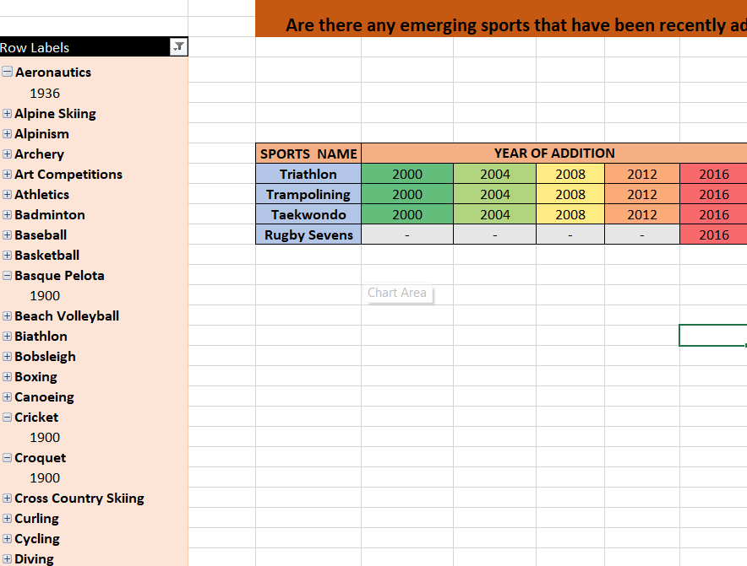
Are there any emerging sports that have been recently added to the Olympics
Trampoline gymnastics made its Olympic debut in 2000. Athletes compete by performing acrobatic routines on a trampoline.
The triathlon, which includes swimming, cycling, and running, was added to the Olympic program in 2000.
Taekwondo: Taekwondo, a Korean martial art, made its debut as an Olympic sport in Sydney.
Rugby sevens, a shorter and faster version of rugby union, was added to the Olympic program in 2016. Both men's and women's tournaments were held.
.

Slide 36
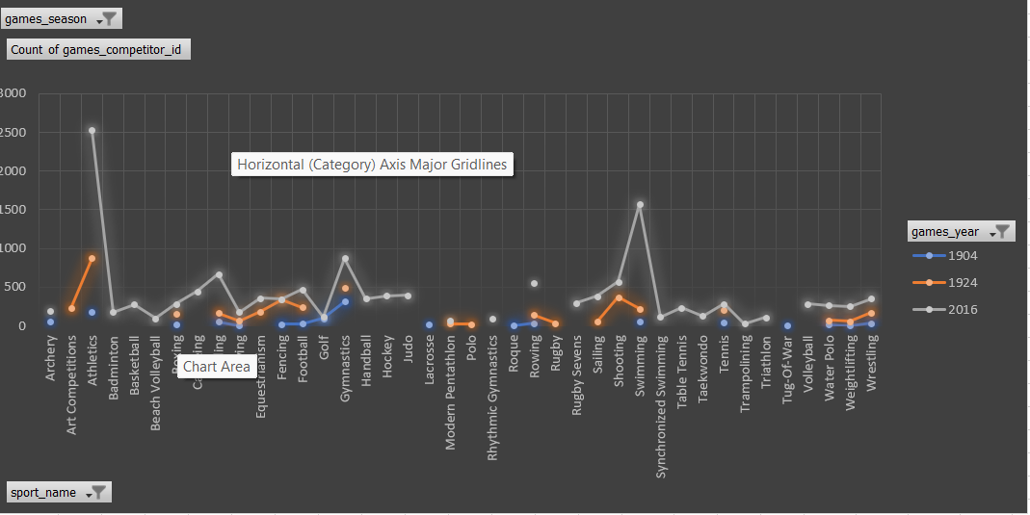
How has the popularity of certain sports changed over the years?
The popularity of sports in the Olympics has evolved over time due to a combination of factors, including cultural influences, societal shifts, technological advancements, and the desire to engage a broader and more diverse global audience. The inclusion of new sports and events reflects the dynamic nature of the Olympic Games and its commitment to staying relevant in the ever-changing world of sports. We can see in graph how the number of participant has increase from year 1904 to2016 .athletics, swimming has gain more And more popularity in summer games, in winter edition cross country sking and ice hockey has gain more numbers From year 1924-2014
.

Slide 37
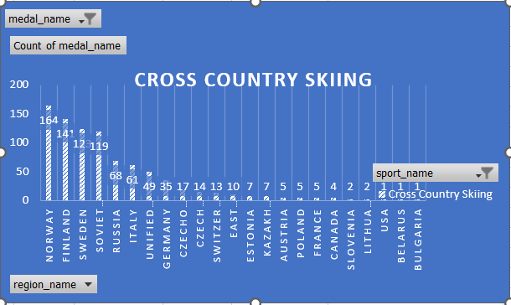
Are there any sports that are specific to a particular region or culture?
DUE TO INSUFFICIENT INFORMATION WE COULD NOT FIND SPORTS WITH SPECIFIC TO PARTICULARE REGION OR CULTURE THOUGH THERE ARE SOME SPORTS LIKE FENCING WHICH IS MORE POPULARE IN EUROPEAN COUNTRY (FRANCE AND ITALY ) SO WE CAN FIND DIFFERENT SPORTS WHICH ARE DOMINATED BY DIFFERENT REGION ON THE BASIS OF MEDAL COUNT LIKE NORWAY DOMINATED IN CROSS COUNTRY SKING IN WINTER OLYMPICS
.

Slide 38
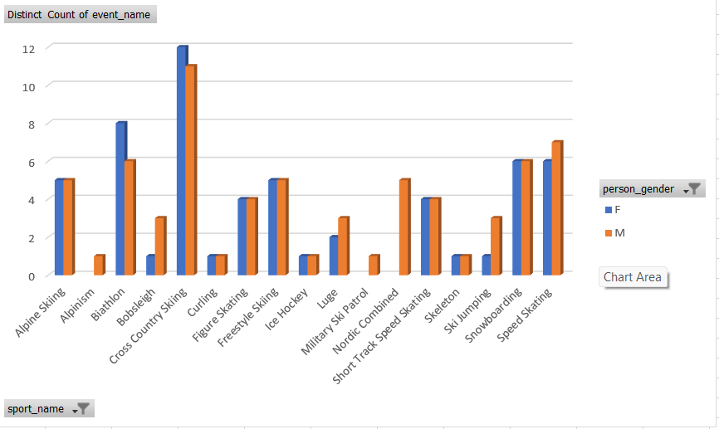
Are there any sports that have a higher number of events for one gender compared to others?
SHOOTING IN SUMMER OLYMPIC HAS MORE NUMBER OF EVENTS FOR MALE FOLLOWED BY ATHLETICS ,SWIMMING AND CYCLING. IN WINTER OLYMPICS CROSS COUNTRY SKINING HAS MORE EVENTS FOR FEMALE
.

Slide 39
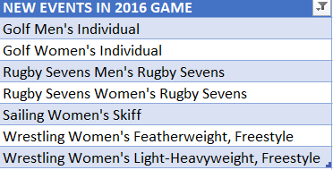
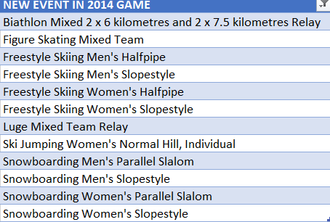
Are there any new events that have been introduced in recent editions of the Olympics?
SUMMER OLYMPICS
.
WINTER OLYMPICS

Slide 40
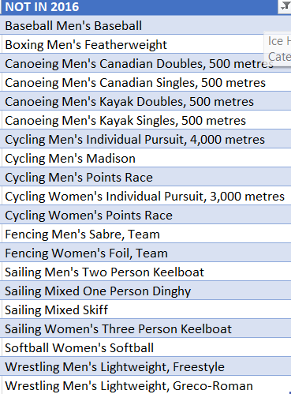
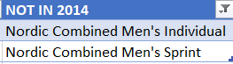
Are there any events that have been discontinued or removed from the Olympics?
SUMMER OLYMPICS
IN RECENT EDTION FOLLOWING EVENTS IN TABLE WERE NOT PART OF THE GAME.WE CAN FIND OUT IN YEAR 2008 AND 2012 SUMMER AND IN YEAR 2010-2014 OF WINTER OLYMPICS BY SIMPLY APPLYING FILTER IN TABLE SUMMER AND WINTER(IN FILTER DO NOT SELECT VALUE 0 ,THE REST WILL BE DISCONTINUE EVENT)
.
WINTER OLYMPICS

Slide 41
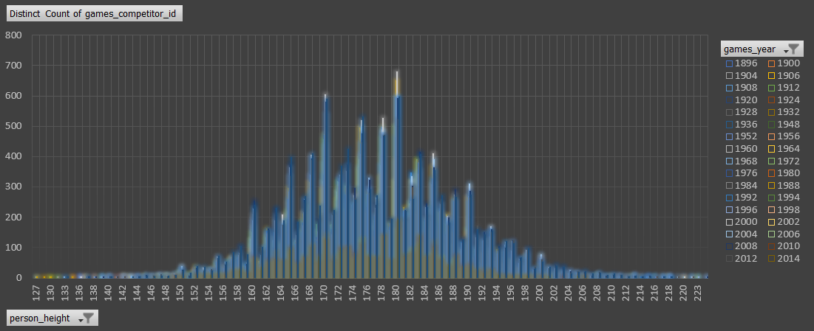
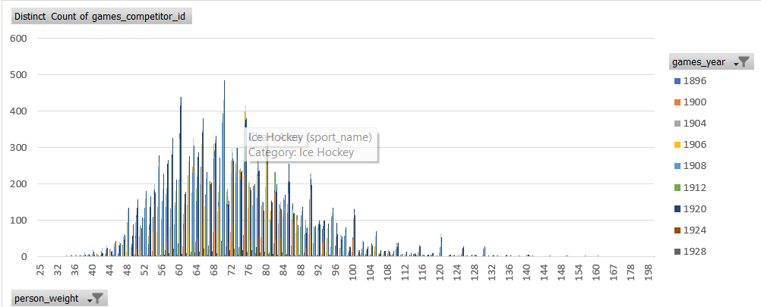
Are there any notable trends in the height and weight of participants over time?
There are some notable trends in the height and weight of Olympic participants over time, although these trends can vary depending on the specific sport and TIME
.

Slide 42
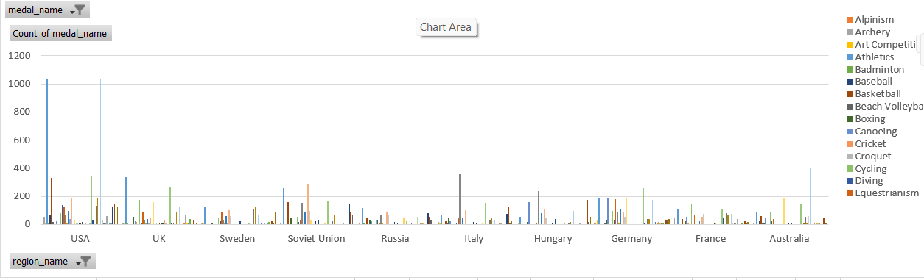
Are there any dominant countries or regions in specific sports or events?
USA IS DOMINATED IN BOTH EDITION OF OLYMPIC GAME IN SPORTS ICE HOCKEY USA HAS 250 MEDALS IN WINTER OLYMPIC AND IN SUMMER OLYMPIC 1035 MEDAL IN ATHLETICS
.

Slide 43
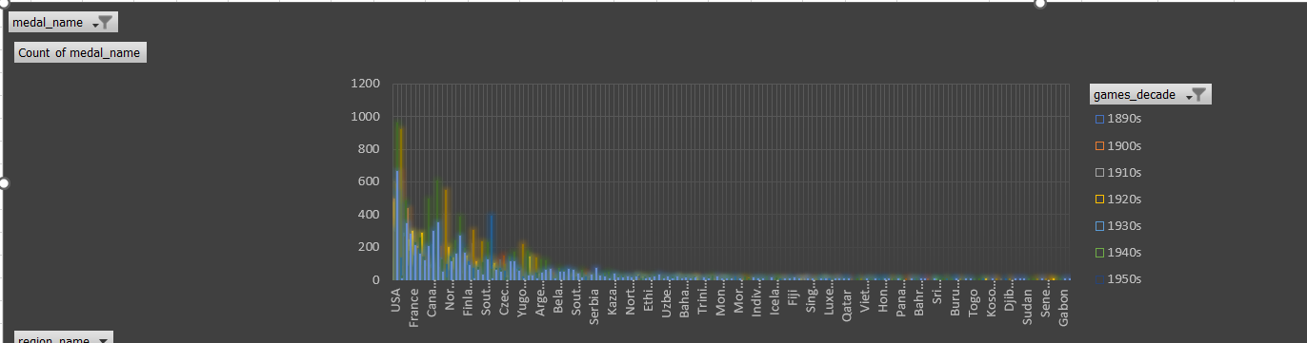
Are there any countries that consistently perform well in multiple Olympic editions?
.
REGION LIKE USA ,UK ,SOVIET UNION(RUSSIA),GERMANY ,FRANCE PERFORM CONSISTENTLY IN MULTIPLE OLYMIC GAMES

Slide 44
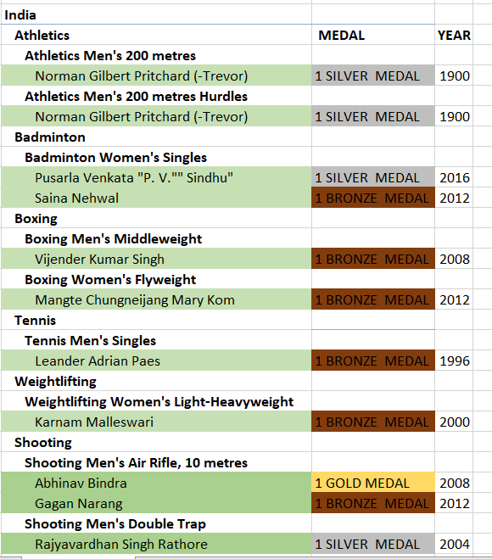
What are some notable instances of unexpected or surprising medal wins?
Abhinav Bindra (2008): Abhinav Bindra made history by becoming India's first individual gold medalist at the Olympics. He won the gold in the 10-meter air rifle shooting event at the 2008 Beijing Olympics.
.

Slide 45
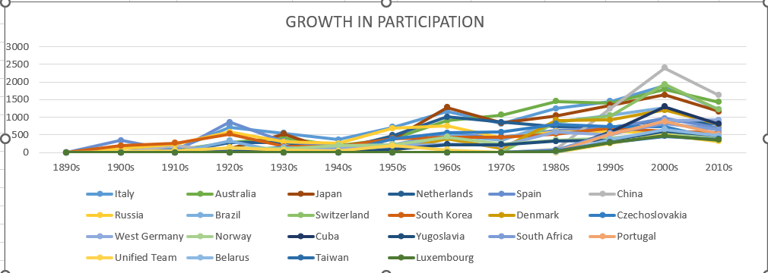
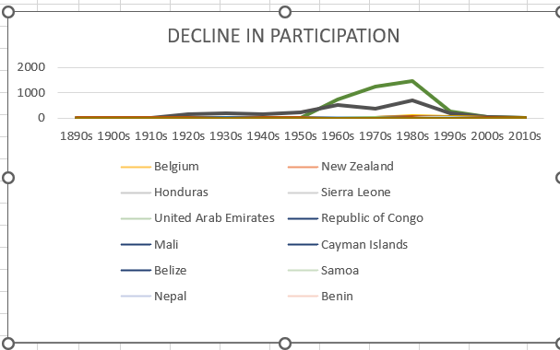
Are there any regions that have experienced significant growth or decline in Olympic participation?
while some regions may experience declines in participation, others may see growth, reflecting the dynamic nature of the Olympic movement. The International Olympic Committee (IOC) and various national Olympic committees work to address these challenges and promote the inclusion of as many countries and athletes as possible in the Olympic Games
.

Slide 46
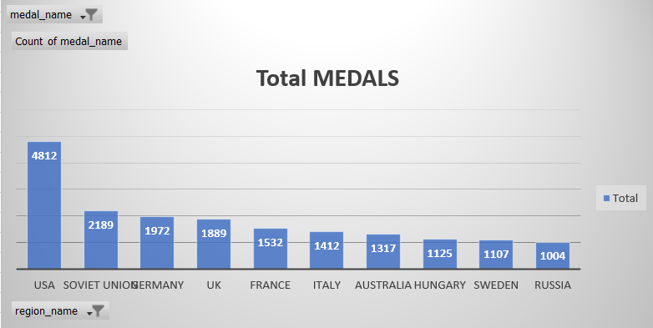
Are there any regions that have had a notable impact on the overall medal tally?
The United States, in particular, has consistently been one of the top-performing countries in the Summer Olympics
.

Slide 47

Conclusion and Future Directions
Thank you for joining us on this exciting journey through Olympic history! In this presentation, we explored the fascinating world of Olympic data with interactive Power BI visualizations and EDA models. The possibilities for further exploration and analysis are endless, and we hope this will inspire you to continue your own exploration of this rich and captivating dataset.

